Slide 1

DA 204o: Data Science in Practice Course Project Proposal
REMOTE WORK AND MENTAL HEALTH:
A Data-Driven Analysis
Sibashis Kumar Sahu, Siemens Healthineers, sibashissahu@iisc.ac.in

Slide 2
Data Science Canvas |  |  | Project: | Remote Work and Mental Health: A Data-Driven Analysis
 |  |  | Team: | Sibashis Kumar Sahu
Problem Statement |  |  |  | Execution & Evaluation |  | Data Collection & Preparation
Business Case & Value Added Which business case should be analyzed and what added value does it generate? Analyze the impact of remote work on employee well-being by identifying factors influencing stress, satisfaction, and health risks. Value Added: 1. Reduce attrition by addressing key stress factors. 2. Guide HR in designing targeted interventions. 3. Improve workplace satisfaction and productivity. | Model Selection Which analysis methods can be considered based on the specific data landscape and the business case? Exploratory Data Analysis (EDA): Identify patterns in stress, satisfaction, and work-life balance. Classification Models: Predict health risks and employee satisfaction. Feature Importance: Highlight key factors driving well-being. Correlation Analysis: Assess relationships between stress, work location, and productivity. | Model Requirements Which model requirements must be complied with to obtain a valid model? Feature Relevance: Include only relevant features affecting employee well-being. Evaluation Metrics: Use precision, recall, and AUC-ROC for balanced assessment. Avoid Overfitting: Use cross-validation. Business Alignment: Ensure model outputs are interpretable and actionable for HR teams. | Skills What skills are needed to provide the data and model development? Data Analysis: Expertise in Python (pandas, numpy) for data cleaning and preprocessing. EDA: Ability to identify trends and correlations using visualization tools (Matplotlib, Seaborn). Machine Learning: Knowledge of classification, regression, and clustering techniques. Model Evaluation: Proficiency in metrics like AUC-ROC, precision, and recall. Domain Knowledge: Understanding of HR and employee well-being factors. | Model Evaluation Which indicators require quality control and validation and how should they be interpreted? Is real-time monitoring necessary? Indicators Requiring Quality Control: Work-Life Balance Ratings: Ensure accuracy through standardized scoring methods. Mental Health Conditions: Verify data consistency and completeness (e.g., "Unknown" values). Predictions: Validate model outputs using metrics like precision, recall, and AUC-ROC. Interpretation: High Stress/Low Work-Life Balance: Indicators of health risks or dissatisfaction. Predictions: Use for targeted interventions in HR. Real-Time Monitoring: Needed if continuous employee health updates are critical, such as during crises or remote work transitions. | Data Storytelling What requirements does the target group have for the presentation of the results and how do I effectively communicate this data? Target Group Requirements: Clarity: 1. Use simple, non-technical language for HR teams. Visualization: 1. Present results via charts (e.g., bar charts, heatmaps, ROC curves). Actionable Insights: 1. Highlight key factors and recommendations (e.g., stress interventions). Effective Communication: 1. Use dashboards or slides for visual summaries. 2. Focus on business impact | Data Selection & Cleansing Which of the available data is relevant? Do the data have to be cleaned up? Relevant Data: Stress Levels , Work-Life Balance Rating , Mental Health Condition, Satisfaction with Remote Work, Age, Gender, Work Location, Industry, Job Role, Hours Worked. Data Cleaning: Handle Missing Values: Fill "Unknown" in mental health with meaningful replacements. Standardize Categories: Ensure consistent formatting for categorical | Data Collection How and with which methods should additionally required data be collected? What properties has this data to fulfil? Methods: 1. Surveys:Collect collaboration and support data. 2. HR Systems: Integrate for productivity metrics. Data Properties: 1. Accurate and validated. 2. Consistent format. 3. Complete with minimal gaps.
Data Landscape Which data is required for this, and which is already available? Which additional data must be collected? From Kaggle: Demographics: Age, Gender, Work Location. Work-related: Job Role, Industry, Experience, Hours Worked. Well-being: Stress Levels, Work-Life Balance, Satisfaction, Mental Health. https://www.kaggle.com/datasets/waqi786/remote-work-and-mental-health/data |  | Software & Libraries Which software should be used? Is there already a standard solution? Which libraries are used? Modules Used: 1. Numpy 2. Pandas 3. Matplotlib 4. Seaborn 5. Scikit-learn 6. XGBoost There are no solutions available as of 05/12/2024 |  |  |  | Data Integration In which system should the data from different sources be migrated? Google Drive as Colab needs to be used if size of dataset increases. | Explorative Data Analysis Are there outliers or structures to be considered? Creation of descriptive key figures for the first assessment of the data. There are no outliers. The EDA is present in the git repository
Adopted from: https://github.com/tomalytics/datasciencecanvas

Slide 3
01.a
Problem Definition
BACKGROUND OF PROBLEM
The problem is to analyze the impact of remote work on employee well-being, focusing on stress levels, satisfaction, health risks, and the balance between work satisfaction and stress. The objective is to identify key factors influencing these aspects to provide insights for improving remote work environments.
DA 204o: Data Science in Practice

Slide 4
01.b
Problem Definition
IMPORTANCE OF PROBLEM
Understanding the impact of remote work on employee well-being is crucial as stress, dissatisfaction, and health risks can reduce productivity and increase attrition. Identifying key factors enables organizations to implement targeted strategies to enhance well-being and foster a positive work environment.
DA 204o: Data Science in Practice

Slide 5
01.c
Problem Definition
OBJECTIVES OF PROJECT
Classify employees' health risks to determine if their health is at risk
Predict whether employees are satisfied with remote work to understand workplace dynamics
DA 204o: Data Science in Practice

Slide 6
01.d
Problem Definition
HOW CAN DATA SCIENCE HELP?
1
2
3
EDA reveals patterns between stress, work location, and satisfaction
Classification forecasts satisfaction with remote work
Feature Importance highlights key factors influencing wellbeing
DA 204o: Data Science in Practice

Slide 7
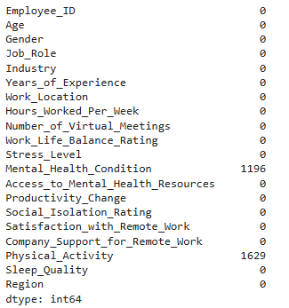
02
Data Preprocessing
How many null values are there and in which features?
1196 in Mental_Health_Condition
1629 in Physical_Activity
DA 204o: Data Science in Practice

Slide 8
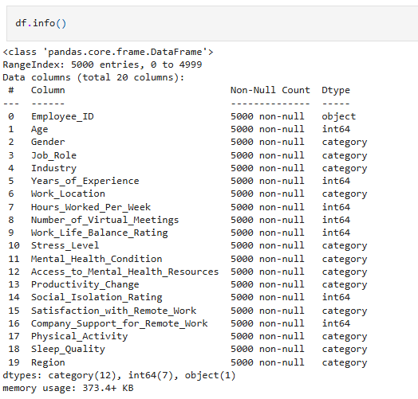
03.a
EDA – General Analysis
Features in the in the dataset - 20
Type of each feature - See table
Number of entries - 5000
DA 204o: Data Science in Practice

Slide 9
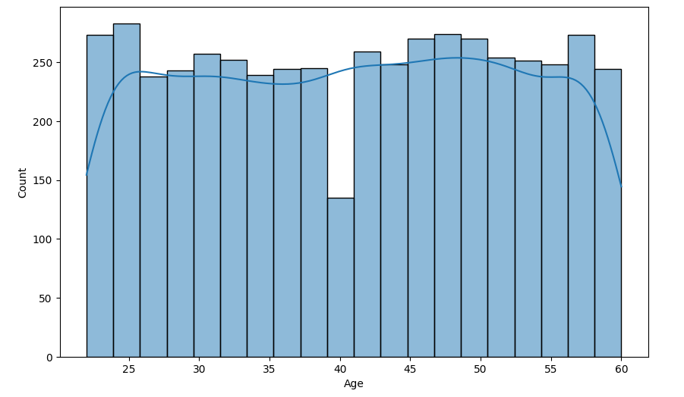
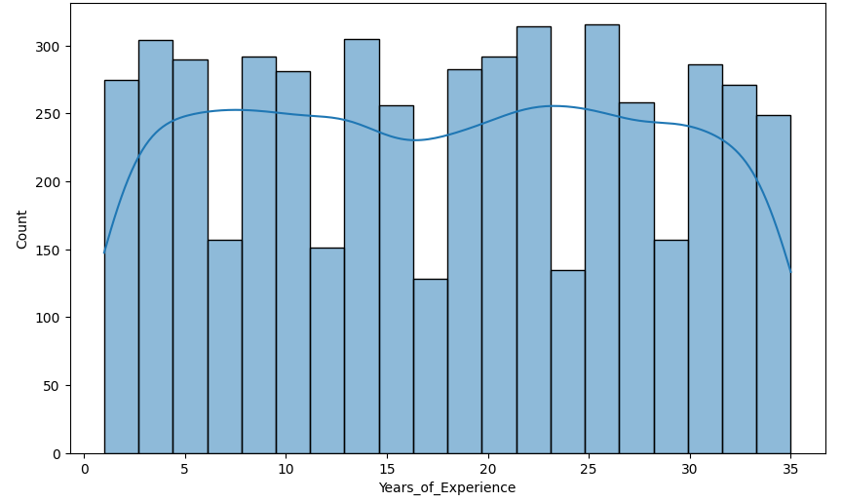
03.b
EDA – Uni-variate analysis 1
Employees in the 40s age range might be underrepresented compared to other age groups, indicating a potential gap or anomaly in the dataset.
Employees distribution is uniform across different experience levels, with periodic dips around specific intervals (e.g., near 10, 20, and 30 years). These dips could indicate a potential lack of representation in those ranges or specific trends in the workforce composition.
DA 204o: Data Science in Practice

Slide 10
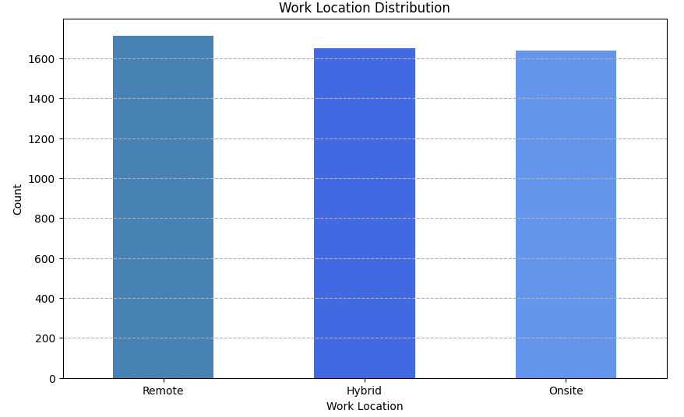
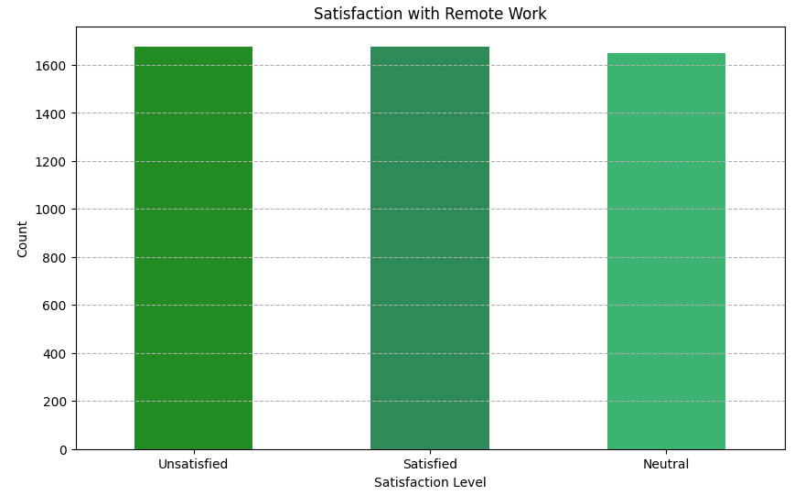
03.c
EDA – Uni-variate analysis 2
Employees are evenly distributed across the three categories: Remote, Hybrid, and Onsite.
Diverse range of opinions about remote work satisfaction among employees, with no single category overwhelmingly dominant.
DA 204o: Data Science in Practice

Slide 11
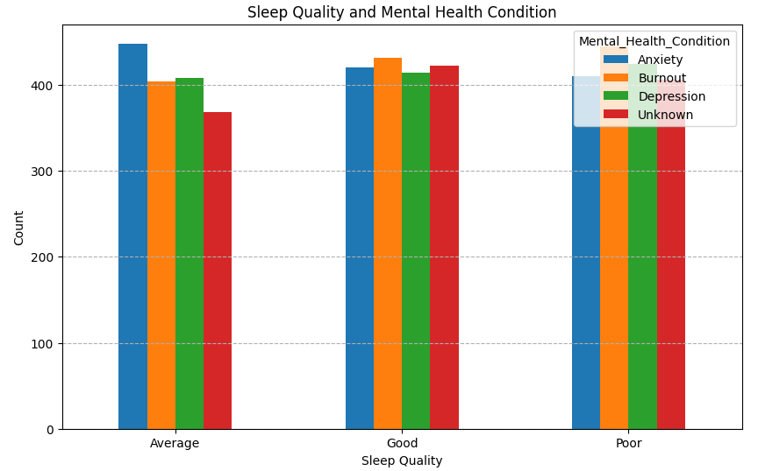
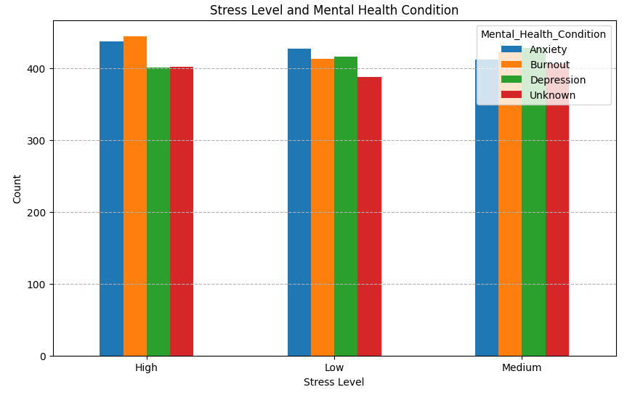
03.d
EDA – Bi-variate analysis
Employees with good sleep quality are distributed more evenly across mental health conditions. Poor sleep quality is associated with a higher occurrence of burnout and depression, highlighting the importance of sleep for mental health.
Anxiety and burnout are more prevalent in employees with high stress levels. Low stress levels are linked with fewer instances of burnout and anxiety, indicating the strong connection between stress and mental health conditions.
DA 204o: Data Science in Practice

Slide 12
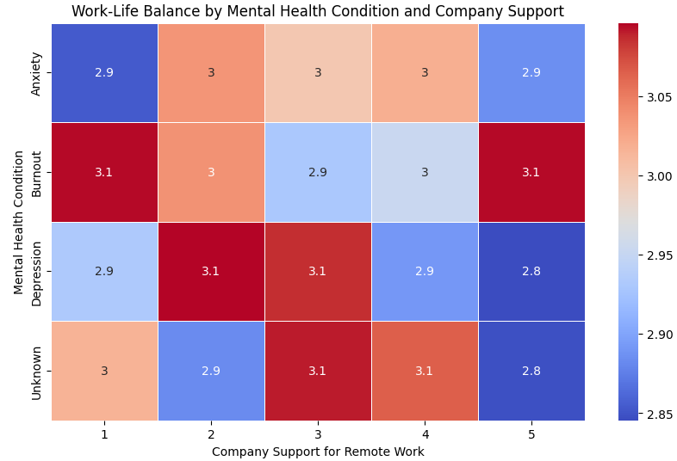
03.e
EDA – Multi-variate analysis 1
Burnout and Depression have slightly higher work-life balance ratings (around 3.1) when company support is moderate (2 or 3). Lower company support (1) generally results in slightly lower ratings (2.9) for most conditions. Unknown mental health conditions and low support (5) show the lowest ratings (2.8), indicating potential gaps in addressing employee needs.
DA 204o: Data Science in Practice

Slide 13
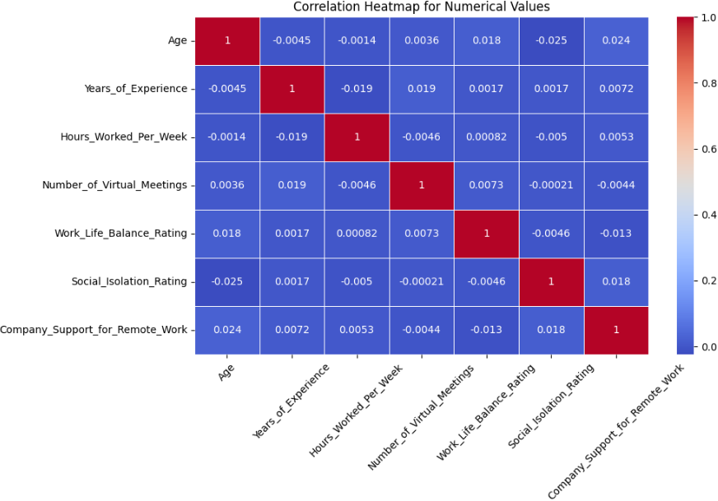
03.f
EDA – Multi-variate analysis 2
Weak correlations across numerical variables as most values are close to 0. No strong relationships between key factors like Work-Life Balance Rating, Social Isolation Rating, or Hours Worked Per Week. Years of Experience and Age are slightly negatively correlated, likely reflecting diverse workforce demographics.
DA 204o: Data Science in Practice

Slide 14
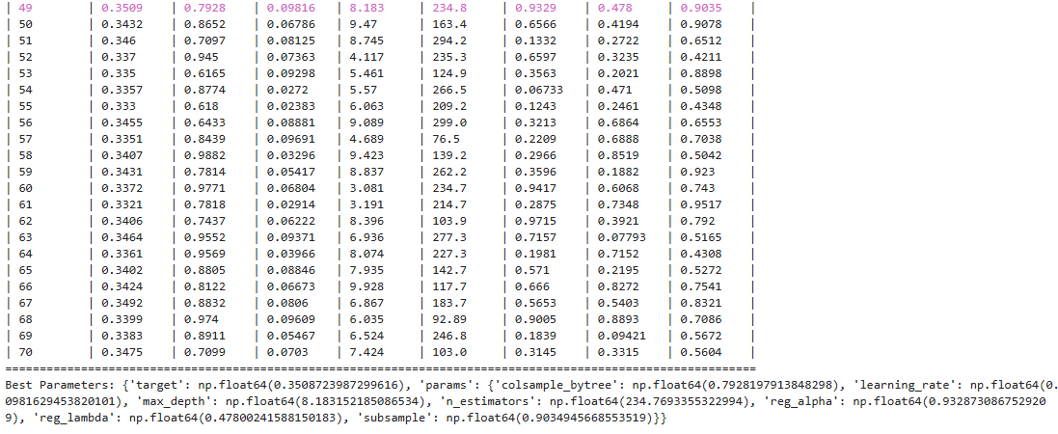
04.a
Data Modelling
XGBOOST CLASSIFIER – for Stress_Level prediction
HYPER PARAMETERS TUNING – using Bayesian Optimization
max_depth: (3, 10)
learning_rate: (0.01, 0.1) n_estimators: (50, 300)
subsample: (0.4, 1.0)
reg_alpha: (0.0, 1.0)
reg_lambda: (0.0, 1.0) colsample_bytree: (0.6, 1.0)
DA 204o: Data Science in Practice

Slide 15
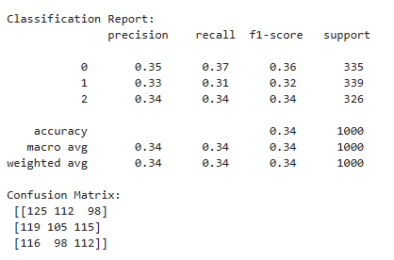
04.b
Data Modelling
XGBOOST CLASSIFIER – for Stress_Level prediction
MODEL TRAINING AND TESTING
The XGBoost Classifier performs poorly:
Accuracy: 34% indicates poor predictive power
Precision/Recall/F1-Score: All are around 0.33–0.36, showing weak performance across all classes
Confusion Matrix: Significant misclassifications across all classes
This suggests the model is struggling to learn meaningful patterns
max_depth: (3, 10)
learning_rate: (0.01, 0.1) n_estimators: (50, 300)
subsample: (0.4, 1.0)
reg_alpha: (0.0, 1.0)
reg_lambda: (0.0, 1.0) colsample_bytree: (0.6, 1.0)
DA 204o: Data Science in Practice

Slide 16
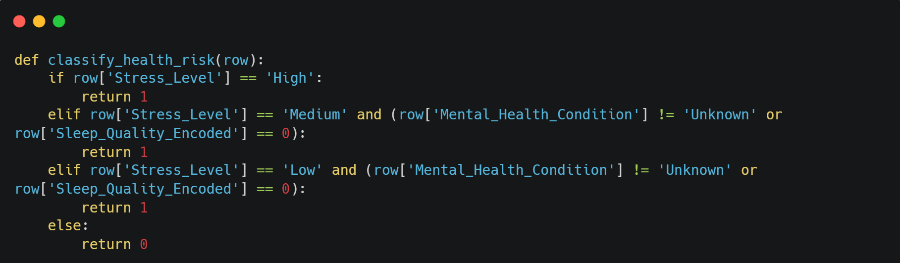
04.c
Data Modelling
LOGISTIC REGRESSION – for Is_Health_In_Risk prediction
FEATURE ENGINEERING
DA 204o: Data Science in Practice

Slide 17
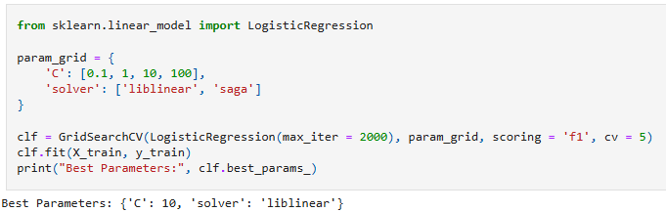
04.d
Data Modelling
LOGISTIC REGRESSION – for Is_Health_In_Risk prediction
HYPER PARAMETERS TUNING – using GridSearchCV
c: 10
solver: liblinear
DA 204o: Data Science in Practice

Slide 18
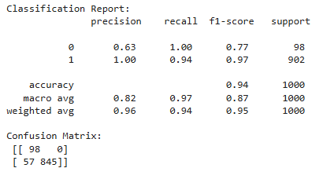
04.e
Data Modelling
LOGISTIC REGRESSION – for Is_Health_In_Risk prediction
MODEL TRAINING AND TESTING
For the Logistic Regression Classifier:
Class 0: High recall (1.00), but low precision (0.63), indicating many false positives for Class 0
Class 1: Excellent precision (1.00) and good recall (0.94), showing strong performance
Overall: Accuracy (94%) is high, but the imbalance between precision and recall for Class 0 suggests the model struggles with false positives for the minority class
max_depth: (3, 10)
learning_rate: (0.01, 0.1) n_estimators: (50, 300)
subsample: (0.4, 1.0)
reg_alpha: (0.0, 1.0)
reg_lambda: (0.0, 1.0) colsample_bytree: (0.6, 1.0)
DA 204o: Data Science in Practice

Slide 19
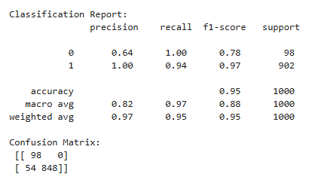
04.f
Data Modelling
LOGISTIC REGRESSION – for Is_Health_In_Risk prediction
CHANGING THRESHOLD
After changing threshold:
Class 0: Precision improved slightly to 0.64, with perfect recall (1.00), meaning all Class 0 instances are correctly identified, though some false positives remain
Class 1: Excellent precision (1.00) and strong recall (0.94), indicating highly accurate predictions for the majority class
Overall Accuracy: 95%, with a balanced weighted average precision and recall
DA 204o: Data Science in Practice

Slide 20
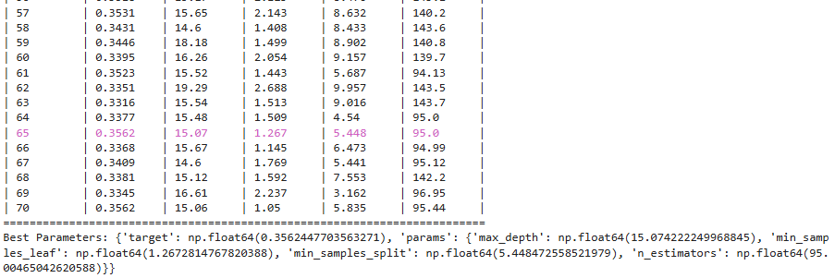
04.g
Data Modelling
RANDOM FOREST CLASSIFIER – for Satisfaction_with_Remote_Work prediction
HYPER PARAMETERS TUNING – using Bayesian Optimization
n_estimators: (50, 300)
max_depth: (3, 20) min_samples_split: (2, 10) min_samples_leaf: (1, 5)
DA 204o: Data Science in Practice

Slide 21
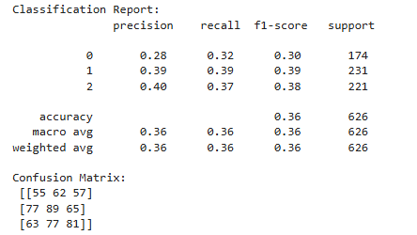
04.h
Data Modelling
RANDOM FOREST CLASSIFIER – for Satisfaction_with_Remote_Work prediction
MODEL TRAINING AND TESTING
The Random Forest Classifier performs poorly:
Accuracy: 36% indicates poor predictive power
Precision/Recall/F1-Score: All are around 0.28–0.40, showing weak performance across all classes
Confusion Matrix: Significant misclassifications across all classes
This suggests the model is struggling to learn meaningful patterns
max_depth: (3, 10)
learning_rate: (0.01, 0.1) n_estimators: (50, 300)
subsample: (0.4, 1.0)
reg_alpha: (0.0, 1.0)
reg_lambda: (0.0, 1.0) colsample_bytree: (0.6, 1.0)
DA 204o: Data Science in Practice

Slide 22
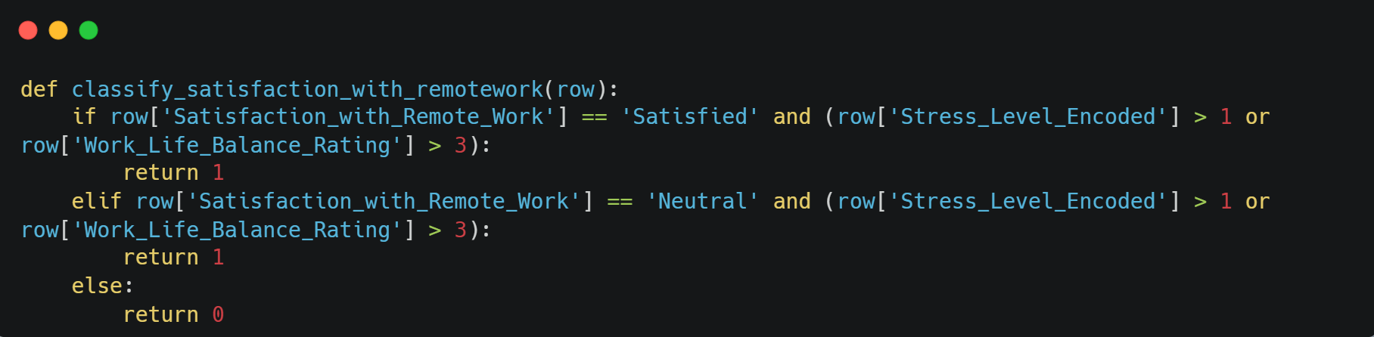
04.i
Data Modelling
RANDOM FOREST CLASSIFIER – for Is_Satisfied_With_RemoteWork prediction
FEATURE ENGINEERING
DA 204o: Data Science in Practice

Slide 23
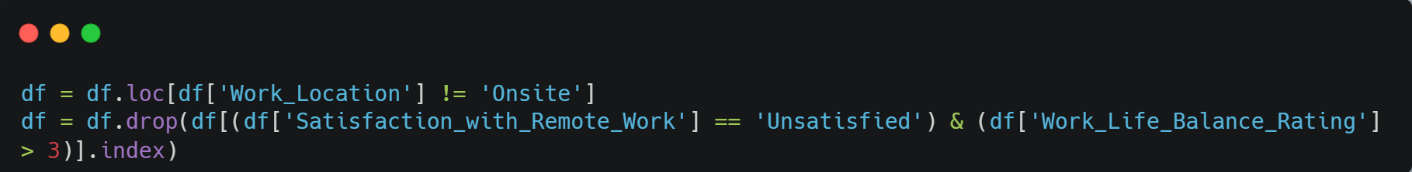
04.j
Data Modelling
RANDOM FOREST CLASSIFIER – for Is_Satisfied_With_RemoteWork prediction
DATA CLEANUP AND REMOVING OUTLIERS
DA 204o: Data Science in Practice

Slide 24
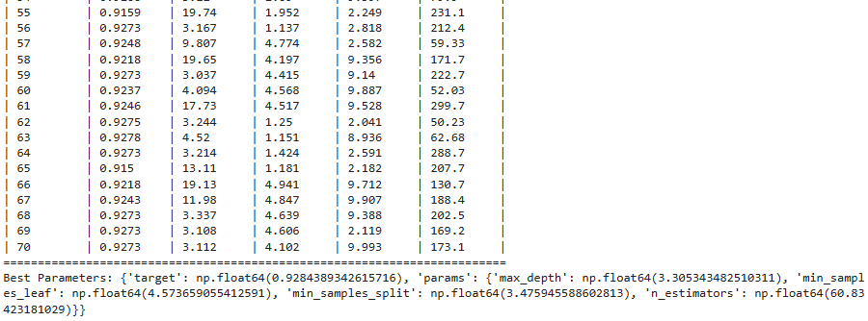
04.k
Data Modelling
RANDOM FOREST CLASSIFIER – for Is_Satisfied_With_RemoteWork prediction
HYPER PARAMETERS TUNING – using Bayesian Optimization
n_estimators: (50, 300)
max_depth: (3, 20) min_samples_split: (2, 10) min_samples_leaf: (1, 5)
DA 204o: Data Science in Practice

Slide 25
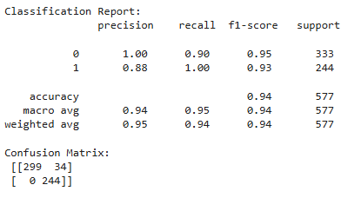
04.l
Data Modelling
RANDOM FOREST CLASSIFIER – for Is_Satisfied_With_RemoteWork prediction
MODEL TRAINING AND TESTING
For the Random Forest Classifier:
Class 0: Perfect precision (1.00) with strong recall (0.90) and F1-score (0.95)
Class 1: Good precision (0.88) with perfect recall (1.00) and F1-score (0.93)
Overall: High accuracy (94%), with balanced performance but slightly lower recall for Class 0
DA 204o: Data Science in Practice

Slide 26
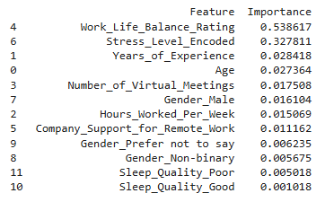
04.m
Data Modelling
RANDOM FOREST CLASSIFIER – for Is_Satisfied_With_RemoteWork prediction
FEATURE IMPORTANCE
DA 204o: Data Science in Practice

Slide 27
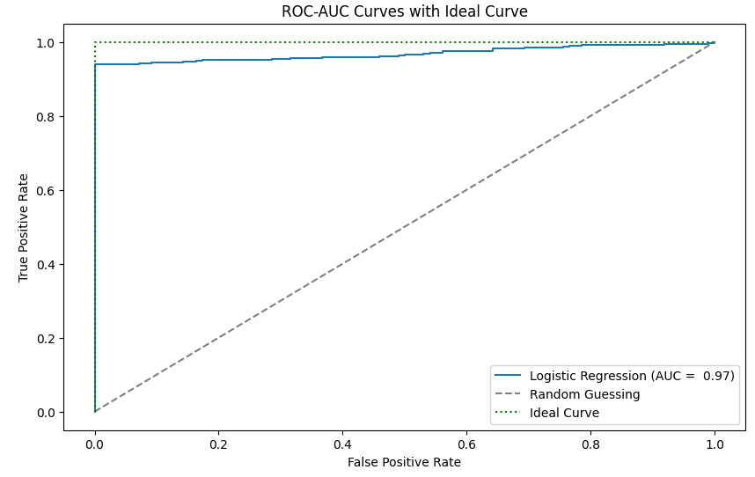
05.a
RESULTS for Is_Health_In_Risk prediction
The ROC-AUC curve suggests the following:
High AUC (0.97): The model has excellent performance in distinguishing between the two classes. An AUC close to 1 indicates a highly effective classifier
Close to Ideal Curve: The ROC curve is very close to the green "Ideal Curve," showing the model has low false positive rates and high true positive rates

Slide 28
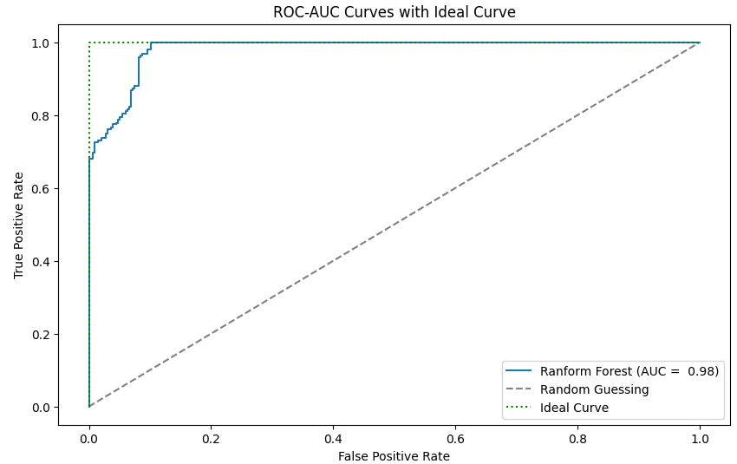
05.b
RESULTS for Is_Satisfied_With_RemoteWork prediction
The ROC-AUC curve suggests the following:
High AUC (0.98): The model demonstrates excellent performance in distinguishing between classes, with near-perfect discrimination
Close to Ideal Curve: The ROC curve closely matches the "Ideal Curve," suggesting minimal false positives and almost perfect true positives

